Slide 1
Genome assembly for sequencing data with highly uneven depth
With IDBA-UD

Slide 2
The problem
Single-genome and metagenome assemblers assume that datasets have even depths, which results in the failure to construct correct long contigs.
This is caused by:
Incorrect k-mers.
Gaps.
Increased number of branches.

Slide 3
IDBA-UD
IDBA-UD adopts the idea of variable thresholds of Valvet-SC and enhances it to become a variable relative threshold, where the threshold is relative to the sequencing depths of the neighboring contigs, to tackle the incorrect k-mers problem. For the gaps and the increased number of branches problems, IDBA-UD adopts the k-mer range idea from IDBA to solve these problems.

Slide 4
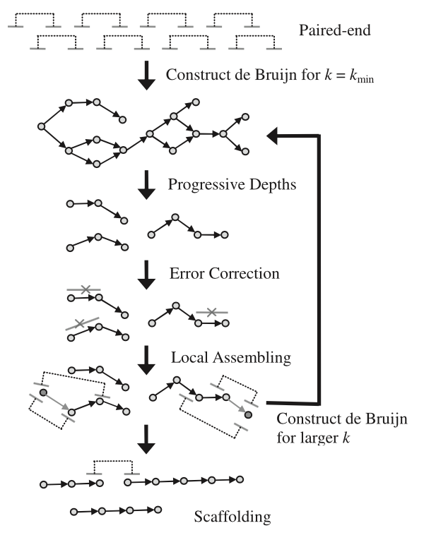
IDBA-UD pipeline
Construct de Bruijn graph
Progressive Depths
Error correction
Local Assembling
Feed a de Bruijn graph the results and increase the k value
Construct contigs and scaffolds

Slide 5
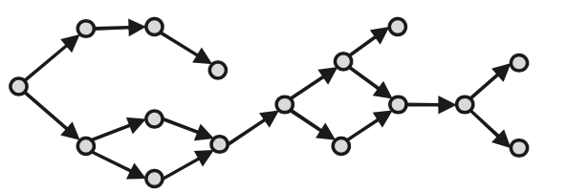
Step 1
Construct a de Bruijn graph from the sequence reads if on the first iteration. Else, construct a de Bruijn graph from the contigs generated from the previous iteration and increase the k value for the k-mer.

Slide 6
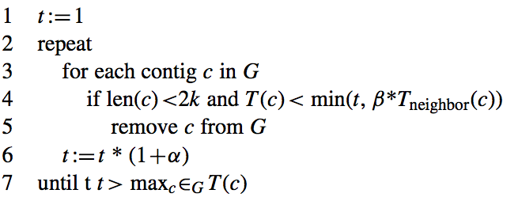
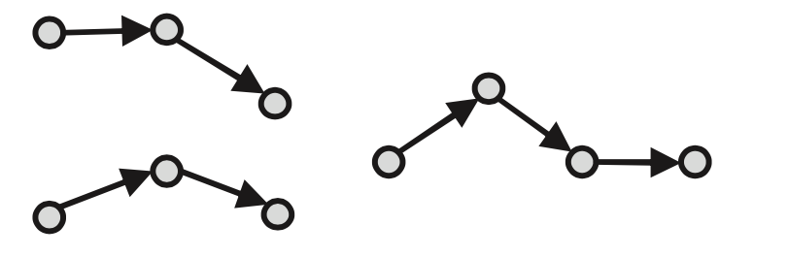
Step 2
Progressive relative depth is a function employed by IDBA-UD to filter the number of contigs generated from every iteration. The algorithm filters contigs based on their length, and their depth relative to the their neighboring contigs.

Slide 7
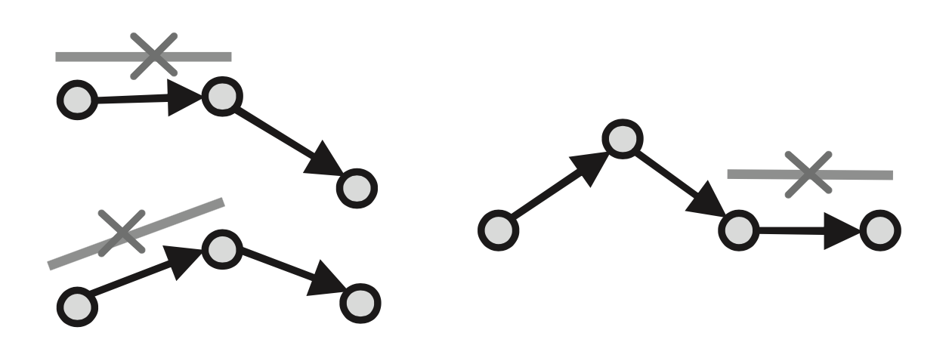
Step 3
Error correction is applied to newly structured contigs based on alignment between reads and confident contigs.

Slide 8
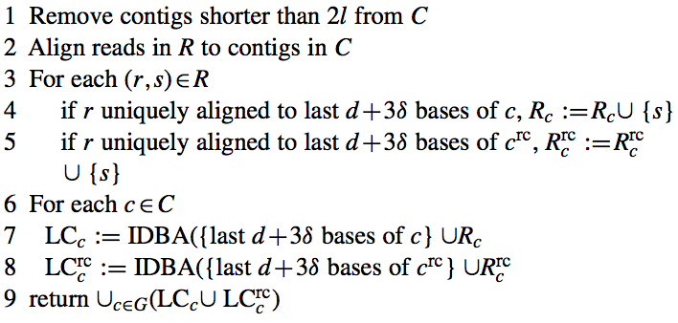
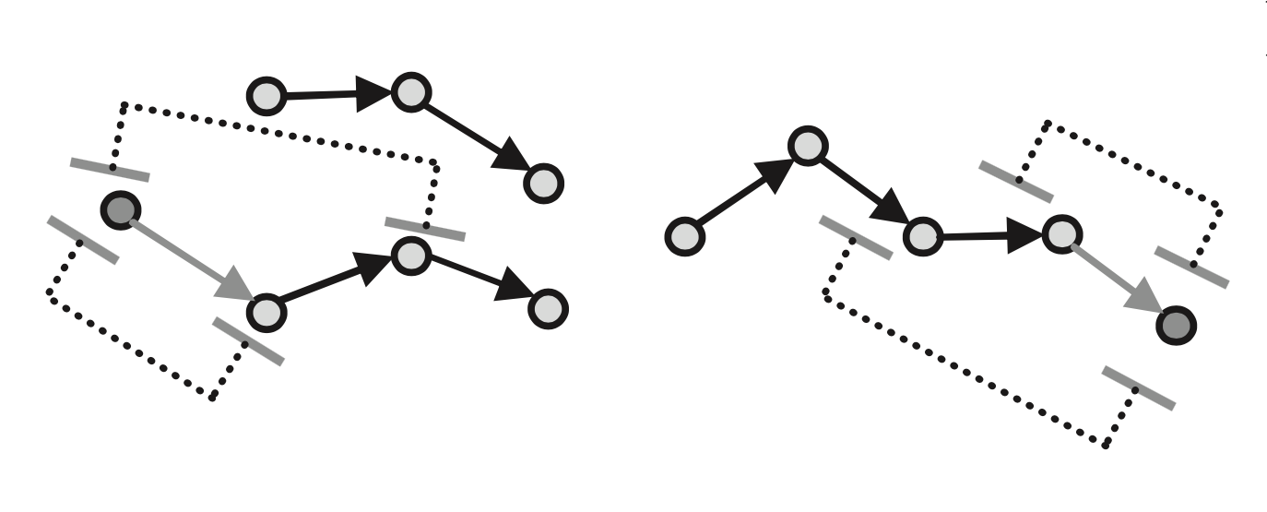
Step 4
Local assembly is used to construct missing k-mers to the gaps in the contigs.
Those missing k-mers cant be constructed even if they do not appear in any of the reads.
However, not all gaps can be filled by local assembly because of the ambiguity caused by branches.
Notes:
AACT, ACTG, 3-mer

Slide 9
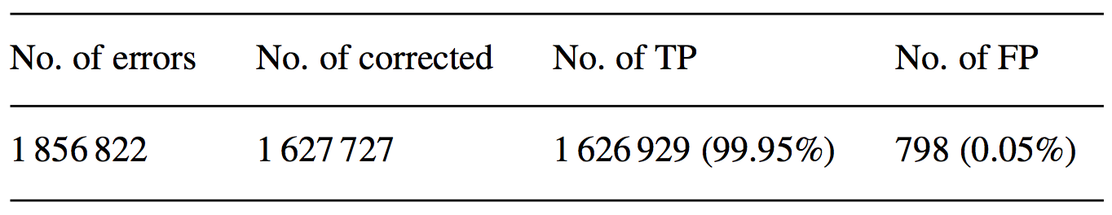
Results
Error Correction When run against reads sampled from Lactobacillus delbrueckii genome with 1 856 822 errors. IDBA-UD was able to correct 1 627 727 errors 99.95% of which were true positive.

Slide 10
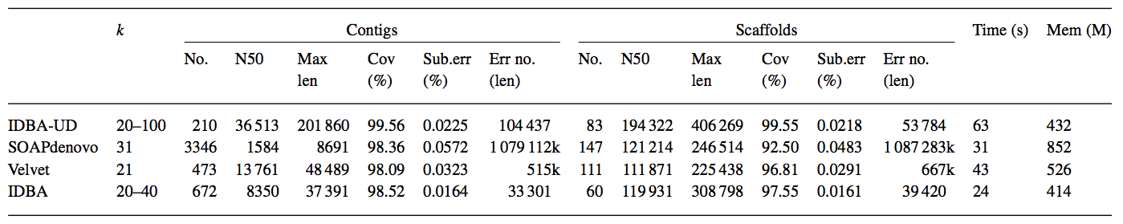
Results
Low depth assembly
The genome Lactobacillus plantarum was used to simulate low-depth dataset

Slide 11
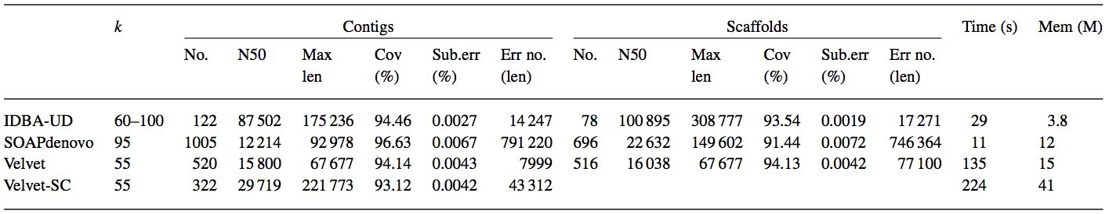
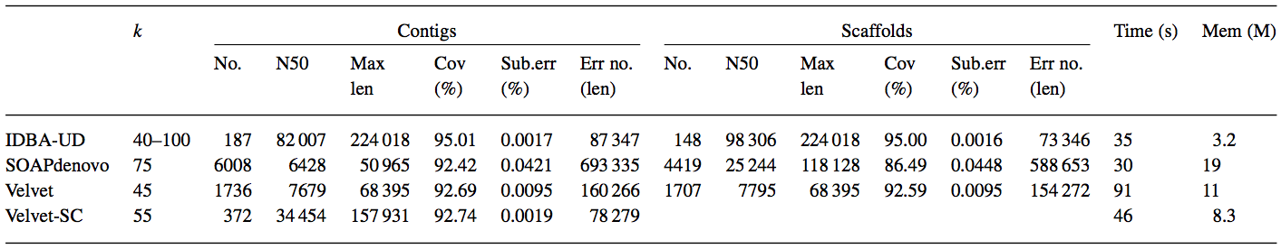
Results
Single cell assembly The results of the Escherichia coli genome are shown in the first table.
The results of the Staphylococcus aureus genome are shown in the second table

Slide 12
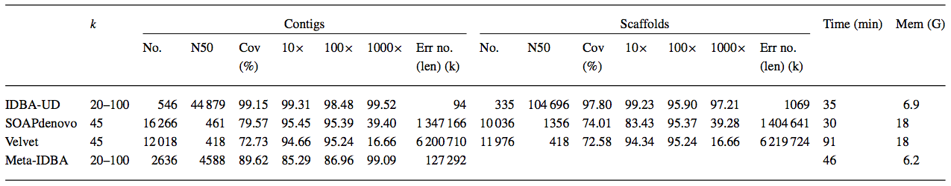
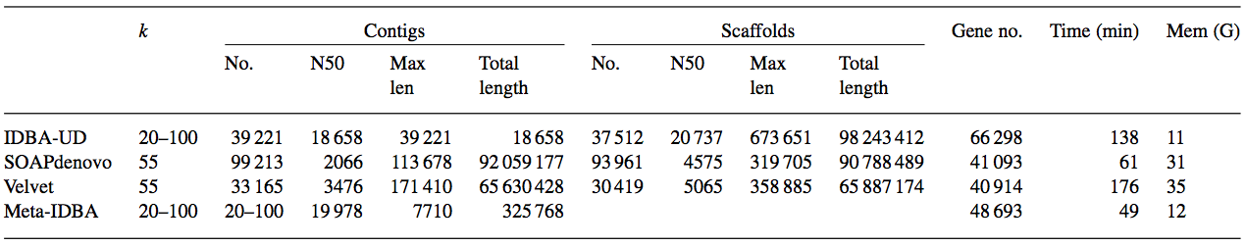
Results
Metagenomic assembly The results of the L.plantarum, L.delbrueckii, and L.reuteri F275 Kitasato genomes are shown in the first table.
The results of a human gut microbial metagenome are shown in the second table

